Slide 1
Scheduled Appointment Status (prev Dr is running late)

Slide 2
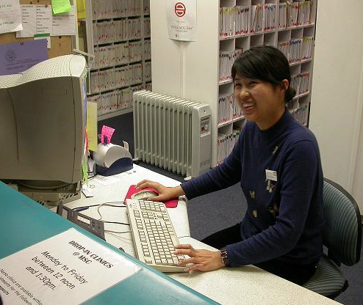
1. Status is monitored and updated by the practice receptionist
I can see that the waiting room is getting full – I’d better set Scheduled Appointment Status
Appvendo Practice Portal
Dr’s Name:
Dr Harvey
Expected wait time from scheduled appointment:
5 mins
Expected duration of delay:
30 mins
Set

Slide 3
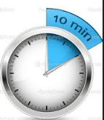

2. Patient opens app to check status
He’s running a bit late – that means I won’t need to hurry
For….
Dr Harvey
you should expect a wait time of about
Last Updated:
08/08/13 – 8:16am
Refresh

Slide 4
3. Practice receptionist is prompted to check and reset status
Opps… I forgot I had set that. Its now worse so I better set it again
Hi, unless you update it, your Scheduled Appointment Status for
will revert to “on time” in 1 minute
Dr Harvey
OK
(message pops up automatically based on the “Expected duration of delay” from original setting – less one minute)

Slide 5
4. Practice receptionist sets a new set of parameters
Better be on the safe side…
Appvendo Practice Portal
Dr’s Name:
Dr Harvey
Expected wait time from scheduled appointment:
10 mins
Expected duration of delay:
45 mins
Set

